Slide 1


MAULANA MUKHTAR AHMAD NADVI TECHNICAL CAMPUS
Affiliated to Savitribai Phule Pune University (SPPU)
Liver Disease Detection using Deep Learning
Name of Students:
Abdul Rahman
Ansari Farzan
Md. Hassan
Isar Ahmed
Shauqi Mauz
Department of Computer Engineering, AY 2024-2025
Guide: Asst. Prof. Master Simmi | Co-guide (Optional): Dr. Salman Baig

Slide 2
AGENDA
Introduction and Aim
Literature Survey
Problem Statement
Project Requirements
Methodology
Model Architecture
Results
Conclusion & Future Work

Slide 3
Introduction and Aims
Liver disease is a major global health issue, often detected late due to the invasiveness and cost of traditional diagnosis.
This project aims to create a deep learning-based model to detect liver diseases using Artificial Neural Networks (ANN) and Convolutional Neural Networks (CNN).
The primary objective: to achieve high classification accuracy and improve early detection.

Slide 4
Motivation and Objectives
Motivation:
There is high mortality linked to late-stage liver disease.
There is a strong need for cost-effective, scalable, and accurate diagnostic tools.
Objectives:
Develop a deep learning model to classify liver disease.
Leverage both structured medical data and AI-generated samples.
Compare model performance (ANN vs. CNN).
Ensure generalizability with high testing accuracy and AUC.

Slide 5
Problem Statement
Early detection of liver disease remains a significant challenge due to limitations in traditional diagnostic methods, which are often invasive, costly, and time-consuming.
Core Problem:
Can we develop a non-invasive deep learning-based model that accurately detects liver disease using patient data?
Key Challenges to Address:
Imbalanced Datasets: Unequal distribution of disease vs. non-disease cases affects model accuracy.
Limited and Heterogeneous Data: Small sample sizes collected from varied sources reduce consistency.
Model Generalization: Ensuring reliable performance on unseen, real-world data for clinical deployment.

Slide 6
Project Requirements
Data Requirements:
Patient records (n=2,391) from Kaggle, Maharashtra labs, and synthetic sources.
Technical Requirements:
Python (TensorFlow, Keras, Scikit-learn).
GPU/CPU for deep learning model training.
Evaluation Metrics:
Accuracy, Precision, Recall, F1-score, ROC-AUC.

Slide 7
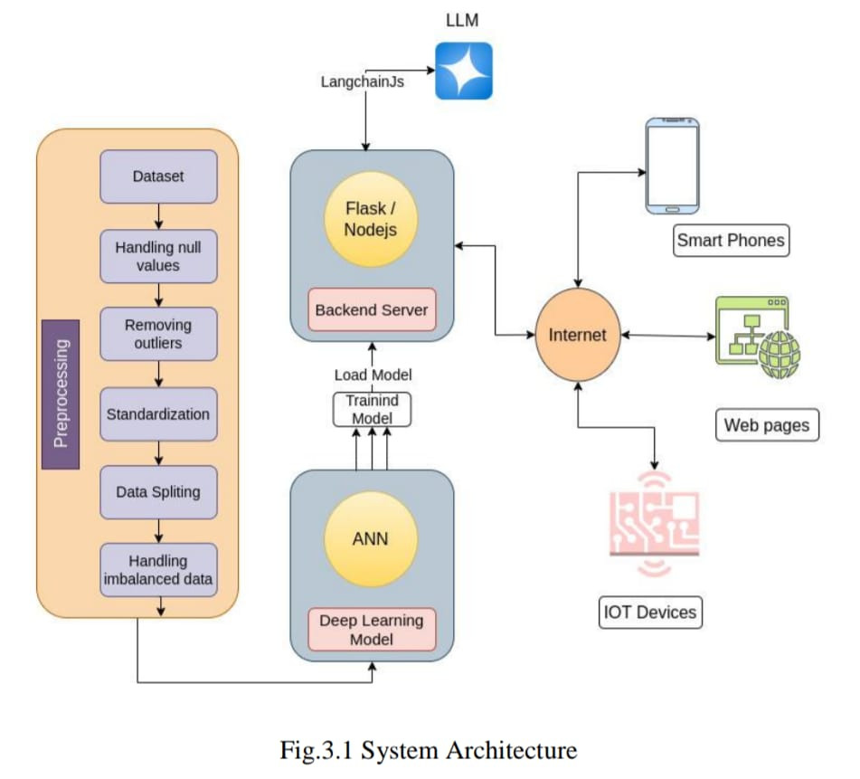
METHODOLOGY

Slide 8
Model Architecture
Artificial Neural Network (ANN) Overview
Model Architecture
Input Layer:
Takes 10 features (patient demographics + clinical biomarkers).
Hidden Layers:
First Hidden Layer: 64 neurons, ReLU activation.
Second Hidden Layer: 32 neurons, ReLU activation.
Output Layer:
1 neuron, Sigmoid activation → binary classification (liver disease: yes/no)

Slide 9
Results
Performance Summary:
ANN (Dropout): 92% testing accuracy, 0.98 AUC.
CNN (3 layers): 91% testing accuracy, 0.98 AUC.
Evaluation Metrics:
High precision (up to 96%), recall (up to 95%), and F1-scores.
Observations:
Models are generalizable and stable across epochs.
While the CNN slightly outperforms in AUC, it is more computationally intensive.

Slide 10
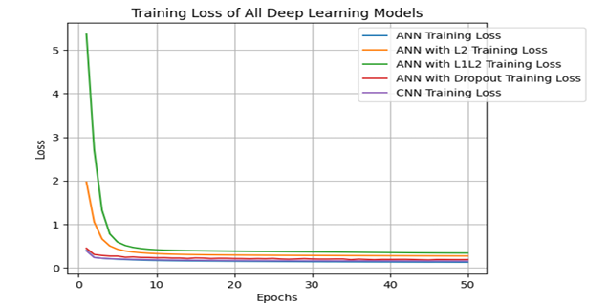
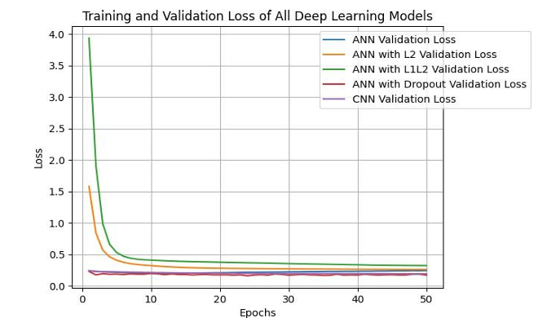
Results

Slide 11
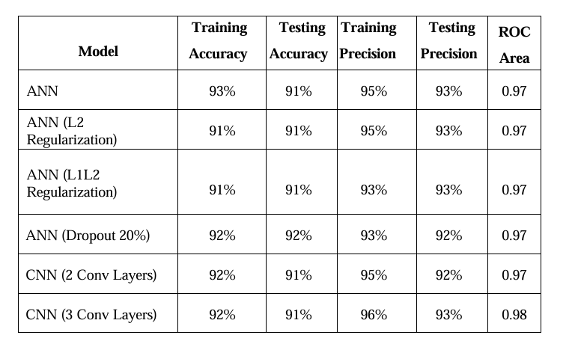
Results

Slide 12
Conclusion & Future Work
Conclusion:
Deep learning models (ANN and CNN) are effective for liver disease detection.
Achieved up to 92% accuracy and 0.98 AUC, proving feasibility for clinical use.
Future Work:
Expand to multi-class classification (detect specific liver conditions).
Integrate real-time data via IoT for continuous monitoring.
Deploy models in clinical environments for validation.
Use larger, more diverse datasets for improved generalization.

Slide 13
Thank You!

